Slide 1


Introduction to Data Science
Dr. Or Haim Anidjar
https://tbtech.co/speechmatics-launches-on-the-microsoft-azure-marketplace-to-offer-any-context-speech-recognition-technology-at-scale/
https://canopylab.com/the-enormous-potential-of-natural-language-processing-nlp-in-learning/

Slide 2
Use Case
You are the CEO of a successful and global world-wide company
Every year, thousands of meeting hours are recorded on daily basis
Missions and summaries are getting lost due to lack of documentation
You want an automatic solution that enables:
Searchable database of specific employees' voiceprints
Determine who spoke when and about what?
What would happen when new customers are being added to meetings?
What is your suggestion?
How would you measure the solution’s quality?

Slide 3

Speech-2-Text
Paper
https://arxiv.org/abs/1609.03193
Github
https://github.com/flashlight/wav2letter

Slide 4
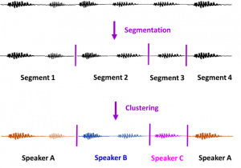
Speaker Diarization
BRNO PLDA -
https://www.isca-speech.org/archive/Odyssey_2020/abstracts/75.html
Number of Speakers - https://arxiv.org/pdf/2004.06756.pdf
DIARIZATION-
https://arxiv.org/pdf/1805.10731.pdf
https://www.ibm.com/blogs/research/2020/10/new-advances-in-speaker-diarization/

Slide 5
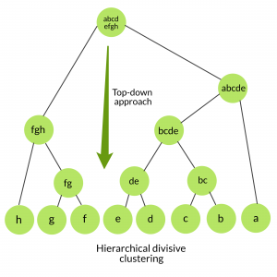
Clustering
https://www.geeksforgeeks.org/ml-hierarchical-clustering-agglomerative-and-divisive-clustering/
https://scikit-learn.org/stable/modules/generated/sklearn.cluster.AgglomerativeClustering.html

Slide 6



Bert Fine-Tuning
Paper https://arxiv.org/pdf/2104.04052.pdf
Demo- https://nlp.biu.ac.il/~elronbandel/alephbert/
https://searchengineland.com/welcome-bert-google-artificial-intelligence-for-understanding-search-queries-323976

Slide 7
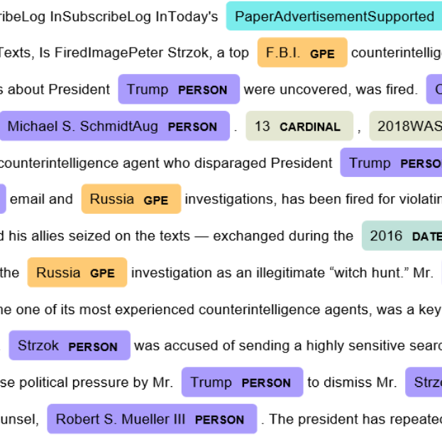
Named Entity Recognition
https://github.com/OnlpLab/NEMO?fbclid=IwAR1-e3h7WiNh0Ao-gXfF2H1Yufs9OrAFN0x5BIiDDmUjL0hXSUc5sluI0ek
Using BERT for NER: https://www.depends-on-the-definition.com/named-entity-recognition-with-bert/
https://medium.com/cogitotech/how-does-named-entity-recognition-work-ner-methods-f23201a69648

Slide 8

Semantic Search
https://github.com/topics/semantic-search
https://github.com/allenai/s 2search

Slide 9

Logistics
Grade
100% - Final Exam
Home Assignments
Uploaded to a public- Open-Source Github repository
Contain a report
Home Assignments – Recommended

